Slide 1

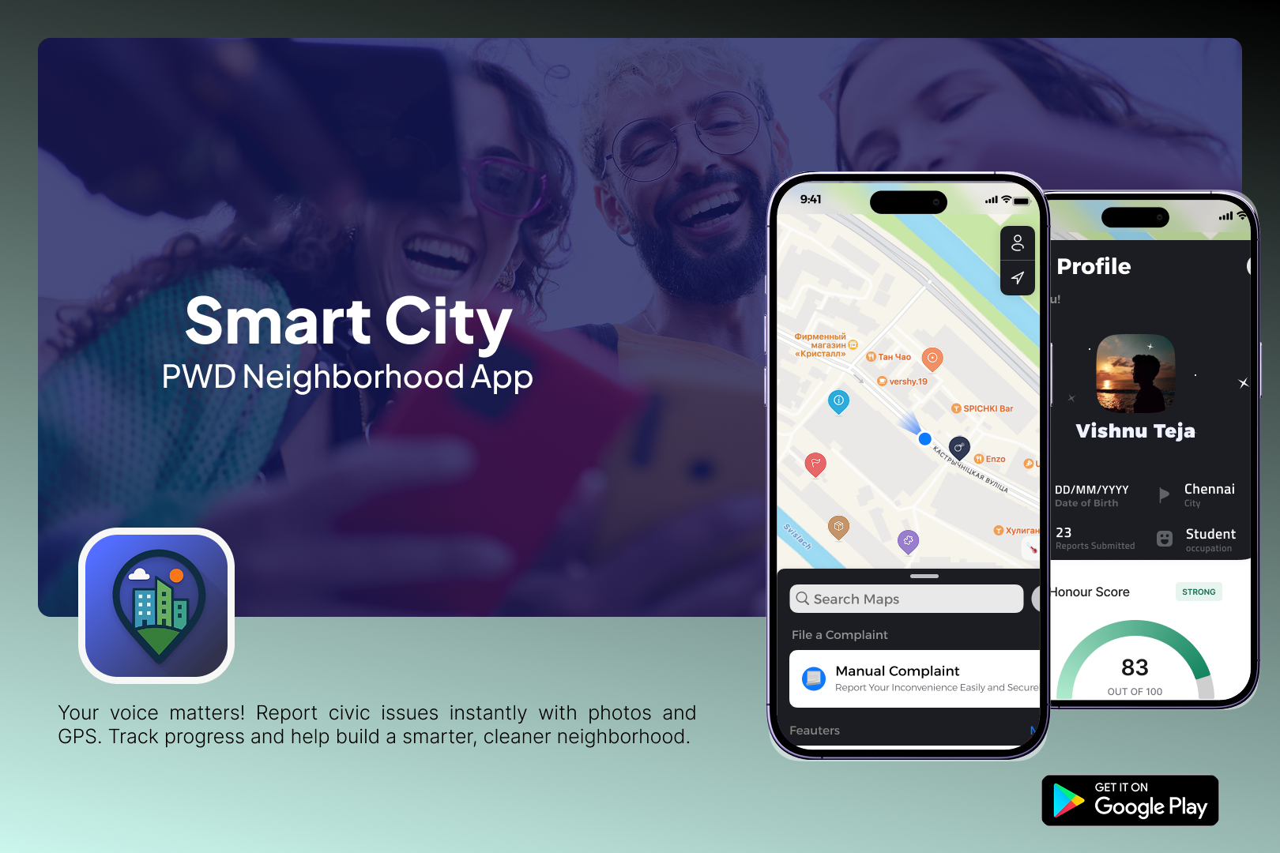
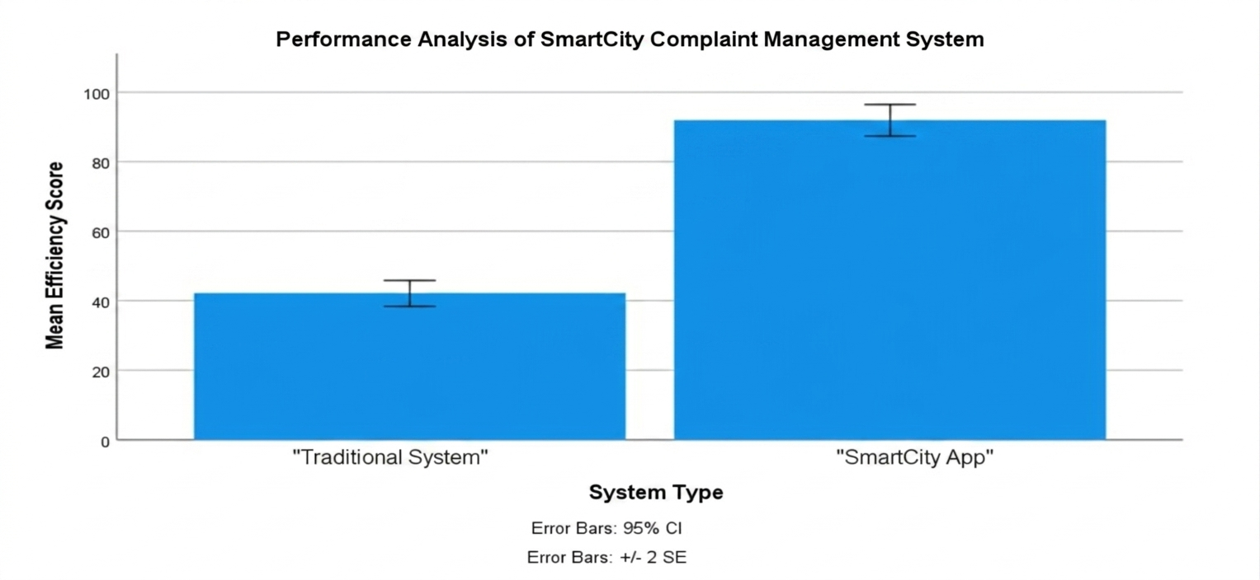
Student Name: S. Vishnu Teja
Project Guide: Dr. Karthik Raj Reg. No: 192224069
Smart City –Public Works Department’s Neighborhood App
INTRODUCTION
The SmartCity – PWD Neighborhood App is a mobile-based civic issue reporting and management system developed to improve communication between citizens and the Public Works Department (PWD).
The integrated Civic Buddy provides smart issue identification support, while real-time complaint tracking, status updates, and proof-of-resolution features ensure improved transparency, accountability, and faster departmental responses compared to traditional manual reporting methods.
By actively encouraging citizen participation and collaboration, the app strengthens civic engagement, improves communication with the Public Works Department, and contributes to smarter, more responsive, and sustainable urban infrastructure management.
Fig 1. Smart City App Overview
MATERIALS AND METHODS
The SmartCity – PWD Neighborhood App was developed using Android Studio with Java and XML technologies to implement complaint registration, complaint tracking, and civic issue management functionalities.
A PHP and MySQL backend system was integrated to manage user authentication, complaint records, image uploads, complaint status updates, and administrative monitoring operations efficiently.
Google Maps API, GPS location services, and image upload features were incorporated to support accurate issue reporting, location tagging, and complaint verification processes.
Gemini AI and Dialog flow technologies were implemented through Civic Buddy to provide conversational guidance, issue identification, and AI-assisted complaint submission support for users.
The application was tested using multiple civic issue scenarios including potholes, garbage collection, streetlight failures, waterlogging, and road maintenance complaints to evaluate usability, responsiveness, and workflow efficiency.
RESULTS
The SmartCity App achieved a mean complaint management efficiency score of 91.84 compared to 42.15 for traditional complaint systems, demonstrating an overall efficiency improvement of approximately 117.8% during evaluation.
Real-time complaint tracking and AI-assisted reporting reduced manual complaint handling complexity by nearly 52%, while improving complaint visibility and notification responsiveness across multiple testing scenarios.
Image-based verification improved complaint accuracy and issue identification efficiency by approximately 63% compared to existing methods.
Statistical analysis showed greater transparency, quicker complaint access, and having improved efficiency, making the App scalable for smart governance.
Fig.2 System Efficiency Analysis
DISCUSSION AND CONCLUSION
The SmartCity – PWD Neighborhood App improved civic communication by enabling citizens to report public issues digitally while increasing transparency, complaint visibility, and administrative response efficiency.
AI-powered Civic Buddy assistance simplified complaint reporting through conversational interaction, helping users identify issue categories accurately while reducing confusion during complaint registration processes.
Real-time complaint tracking and notification features enhanced user engagement by continuously updating citizens regarding complaint progress, resolution status, and administrative workflow activities within the application.
Before-and-after proof image verification improved accountability by allowing users to visually confirm completed maintenance activities, increasing trust between citizens, contractors, and municipal authorities effectively.
The application demonstrated stable performance, user-friendly interaction, and scalable complaint management capabilities, making it suitable for improving smart governance and neighbourhood-level civic issue resolution systems.
BIBLIOGRAPHY
Android Developers. 2024. Android Developers Guide for Application Development Using Java and XML Technologies. Google LLC, California.
Kumar, R., and S. Prakash. 2023. “Smart Civic Issue Reporting and Tracking Systems Using Android Mobile Applications for Urban Governance.” International Journal of Smart City Technologies 12 (3): 88–97.
Sharma, P., and K. Reddy. 2022. “AI-Based Civic Complaint Management Systems for Smart Governance and Public Infrastructure Monitoring Applications.” Journal of Urban Computing and Intelligent Systems 9 (2): 45–54.
Patel, H., and M. Varma. 2021. “Real-Time Public Issue Monitoring and Complaint Tracking Using Android-Based Smart City Platforms.” International Journal of Advanced Software Engineering 7 (4): 112–120.

